Slide 1
DAy-1 Task-1
March-20-2024
by Gona Bhanu Prakash

Slide 2
Thank you

Slide 3
Three tire architecture
Frontend
Backend
Database

Slide 4

Frontend
Firstly, Front-end refers to the user interface, the presentation layer, which is used and interacted by the user directly.
We use HTML, CSS and JavaScript to develop frontend part.
Angular Js, React Js etc.. are some of the advanced technologies in Frontend.

Slide 5
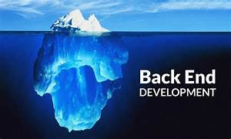
backend
Back-end refers to the logic part which runs in the background. Over here processing of data, Handling requests etc... key aspects are done. This is the application layer.
We use Programming languages such as Java, Python etc… to develop the backend part.

Slide 6
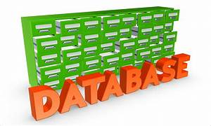
database
Lastly, Database is the structured arrangement of data. Typically it is used to store large amount of data.
This is the Data layer.
Dbms(Database management system) is the software which enables user to interact with the database.

Slide 7
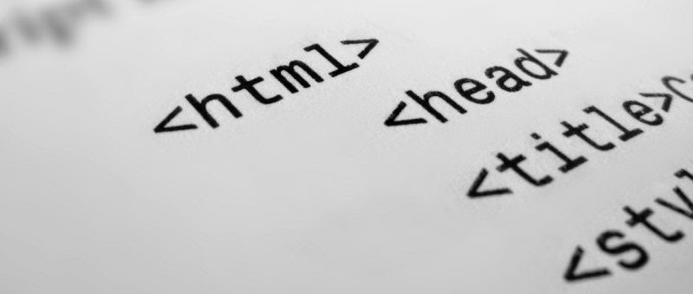
HTML
HTML(Hyper Text Markup Language) is the standard Markup which is used to create and design Web pages.
HTML provides a structure for the content using HTML tags and elements
These components are later styled by using CSS
Javascript is Used to attain interactivity.

